Slide 1

How to Activate Unique Account Number (UAN) ?
Employee should activate UAN No. through the link (https://unifiedportal-mem.epfindia.gov.in/ ).
Leverage or benefits are:
Once the UAN No. activated- An eligible employee:-
Can access EPF Contribution online
Download Individual Passbook
Transfer of Previous Account No
File EPFO Nomination online

Slide 2
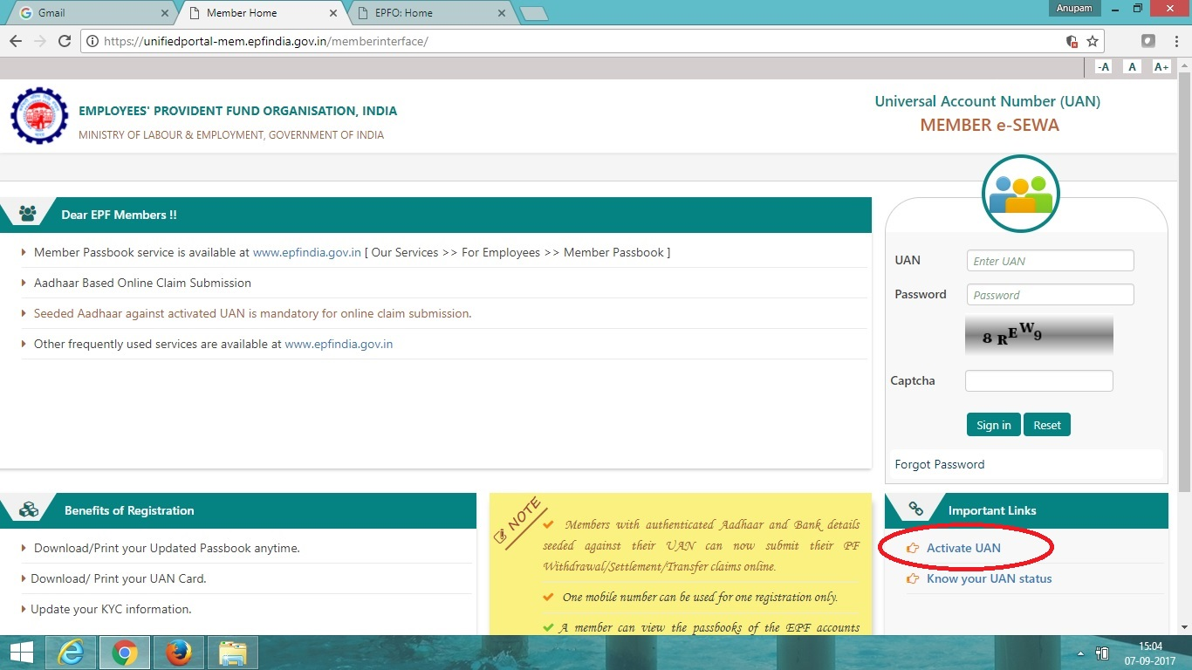
UAN ACTIVATION STEP 1

Slide 3
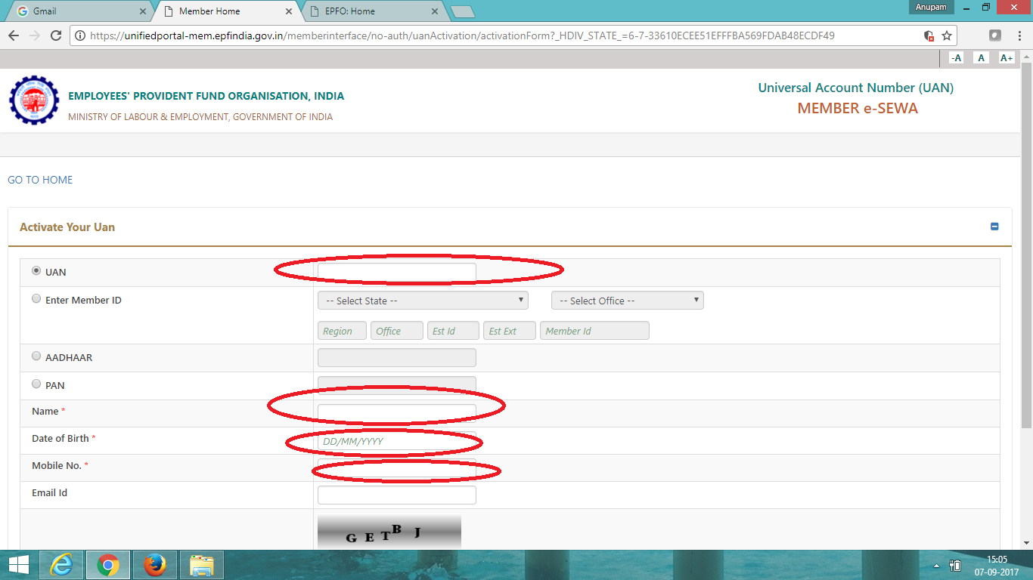
UAN ACTIVATION STEP 2

Slide 4
HOW TO DOWNLOAD MEMBER PASSBOOK
Log on to www.epfindia.com
Select Our services then Employee
Then Click on Member Passbook
Check member passbook with UAN No. and Password

Slide 5
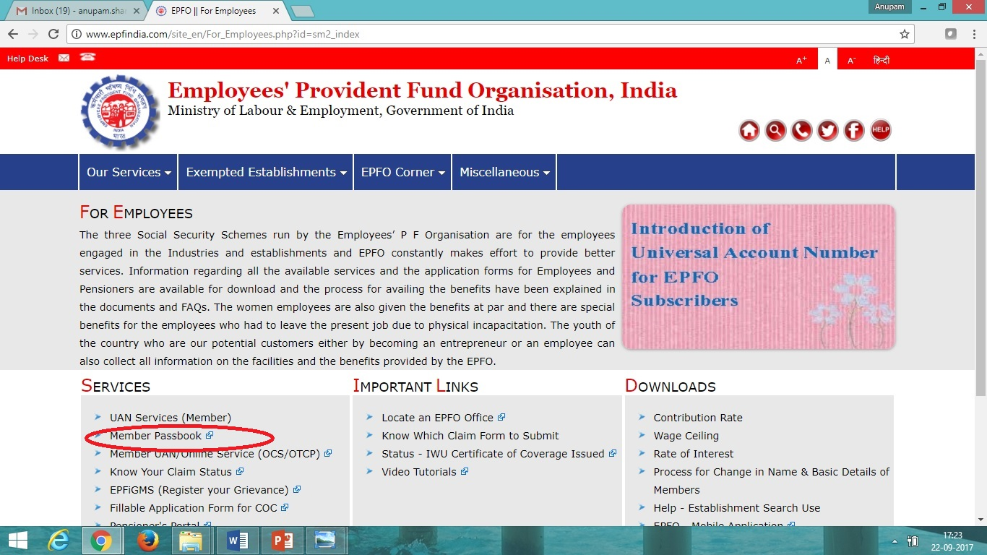

Slide 6
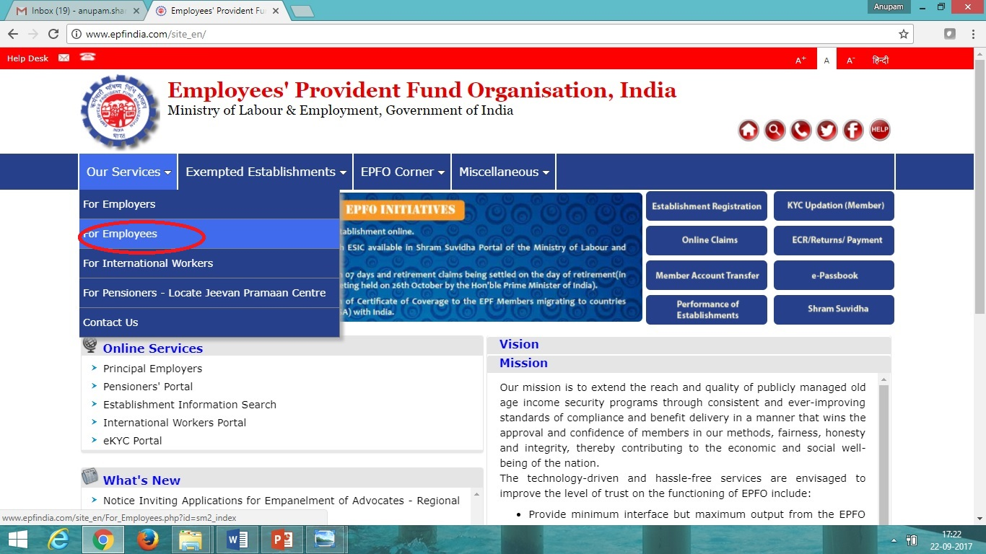

Slide 7
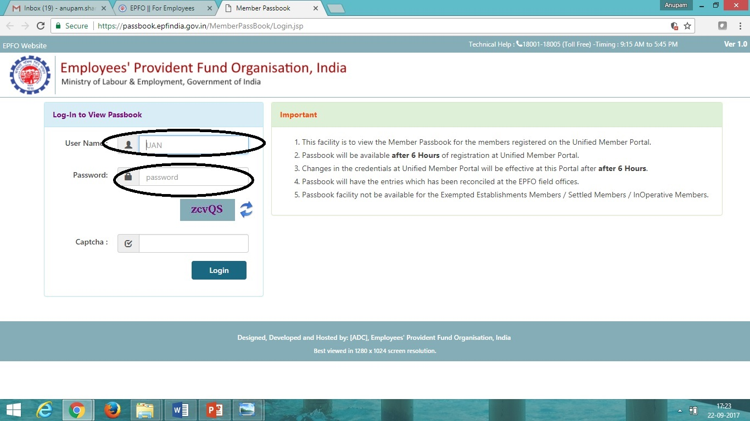

Slide 8
How to file E-Nomination & KYC.
Once the UAN No. activated employee can file e-Nomination KYC Update with e-Sign
First Complete your details which include contact no address photo etc.
Second complete your Bank account and PAN card Updation.

Slide 9
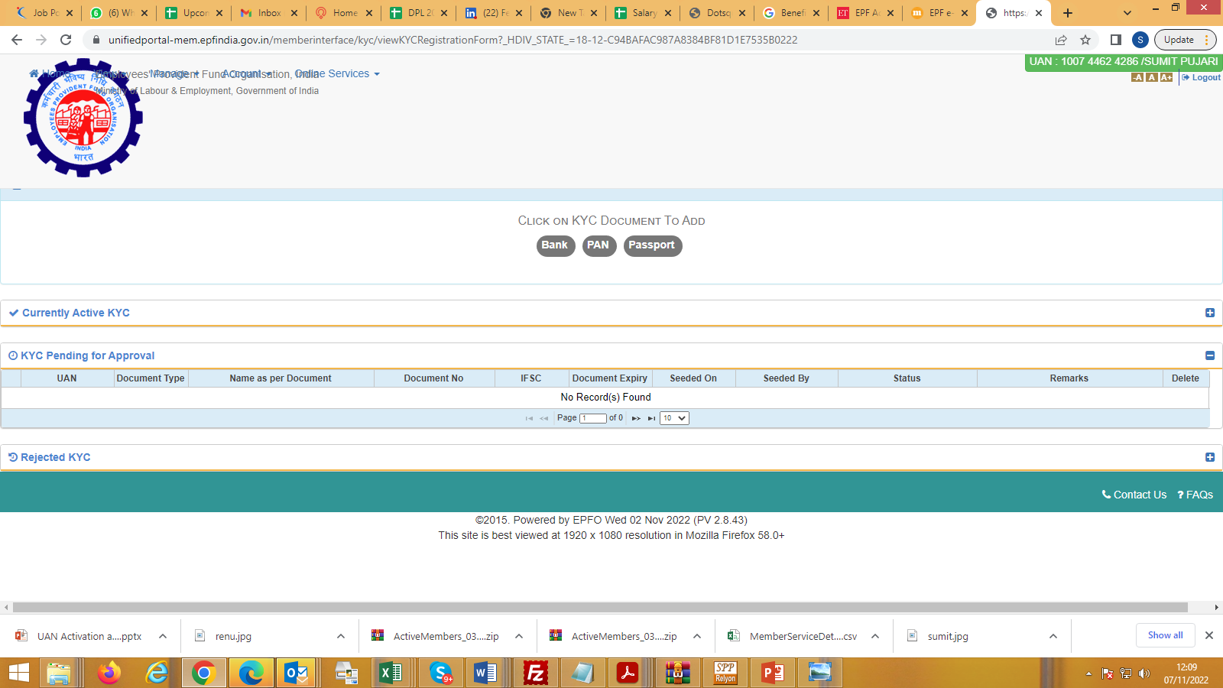
Step 1: Complete KYC

Slide 10
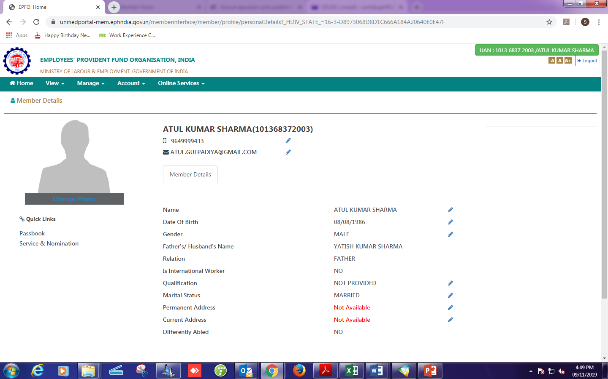
Step 2: Complete Blank Details

Slide 11
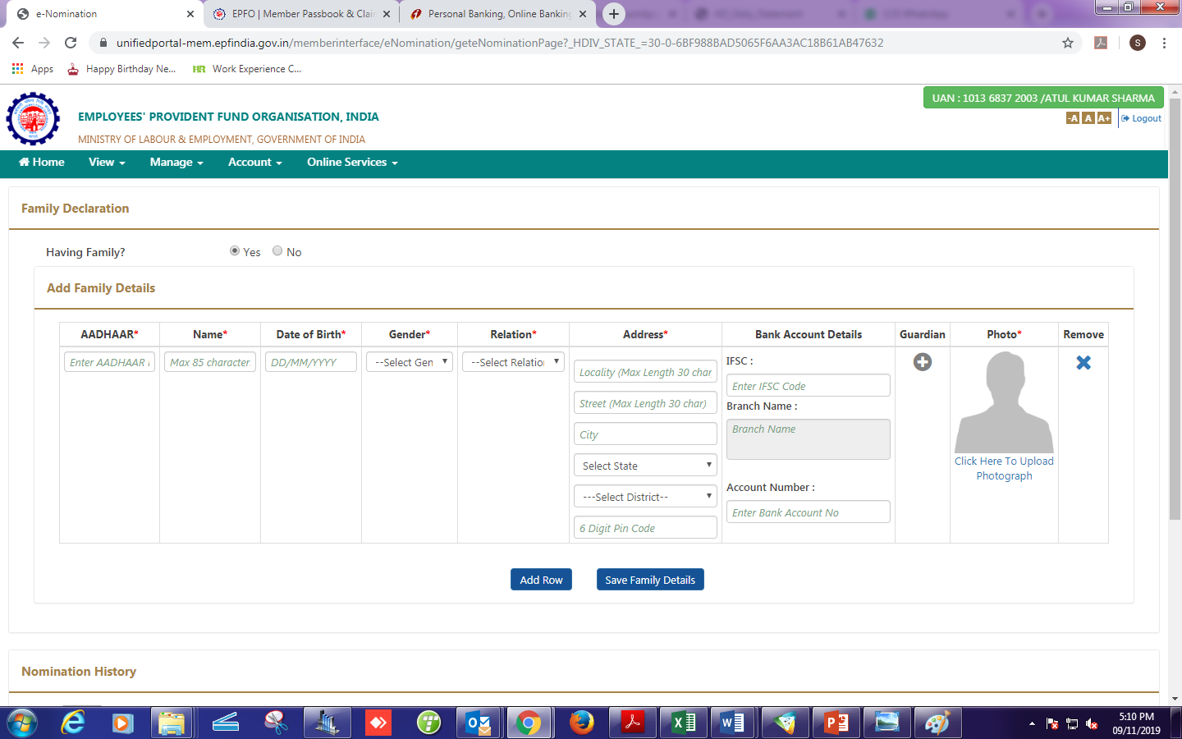
Step 3: Fill details for nominee and upload his/her photo than submit

Slide 12
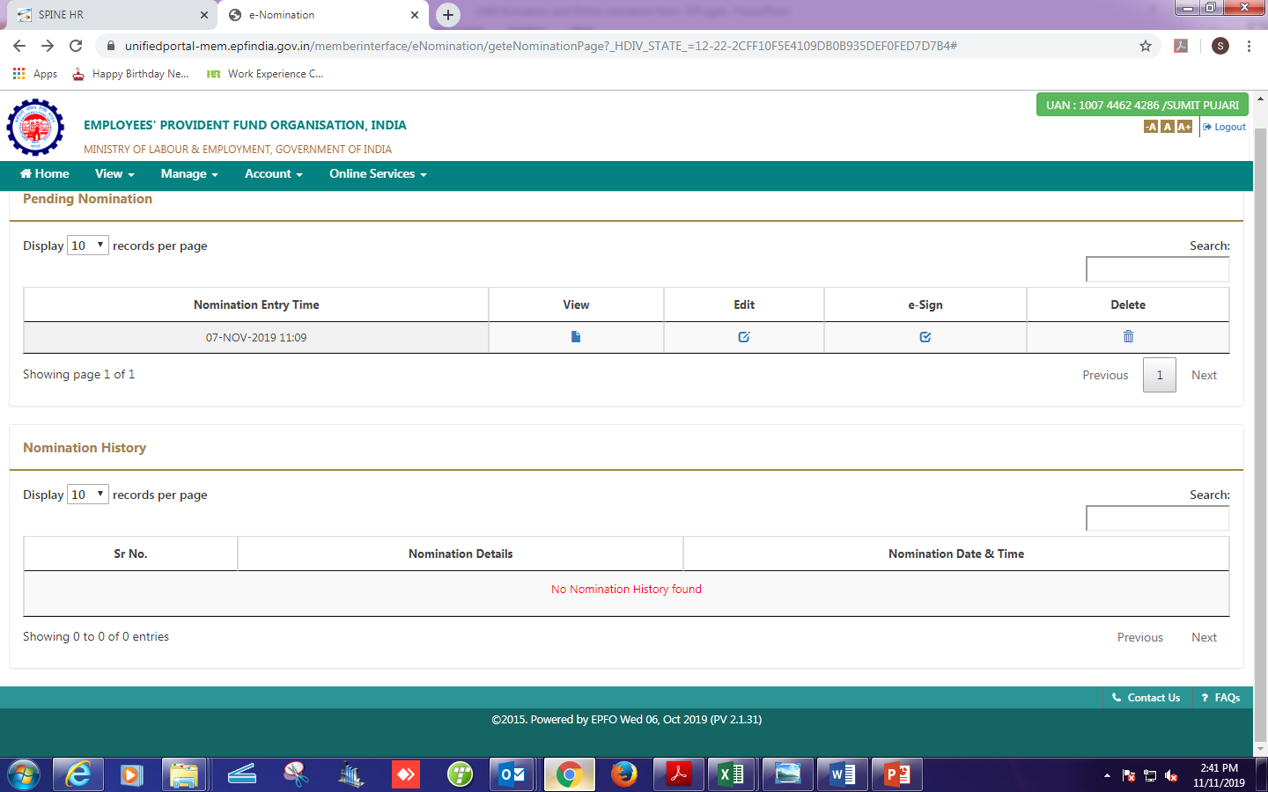
Step 4: Verify via E-Sign

Slide 13
THANK YOU
For Support you may contact
HR DEPARTMENT

